Slide 1
The Frame Problem : A Python notebook
The aim of this project is to understand the various approaches to Frame problem by working them out over finite transition systems, encoded in Python.
Aayush Choudhary
(20328469)
Date 14th April 2022
Notes:
The Frame Problem is a classic problem in AI concerning the changes and non-changes that arise from performing actions. The frame problem in simple words frame problem is the problem of representing the effects of action in First-order logic without having to represent explicitly a large number of intuitively obvious non-effects. For example, there is a robot who has to open a door but there are many factors evolve like whether the door is locked or not, how is the handle of door (shape and type), etc. Now if there is change in door locked or not locked status robot still has to know how is the handle of door which is obviously in same shape and type.
Motivation behind dealing with this particular problem is that automation will make human work minimal and frame problem is an obstacle in it.

Slide 2
Overview
Background
Allen interval relations
Action languages
How these relate to frame problem
Demo of Artefact
Implementation Issues
Future Work

Slide 3
Background & Related Work
Allen interval relations
Action languages
How these relate to frame problem
Notes:
There is a lot of stuff to discus to I won’t repeat let’s just straight move on to these

Slide 4
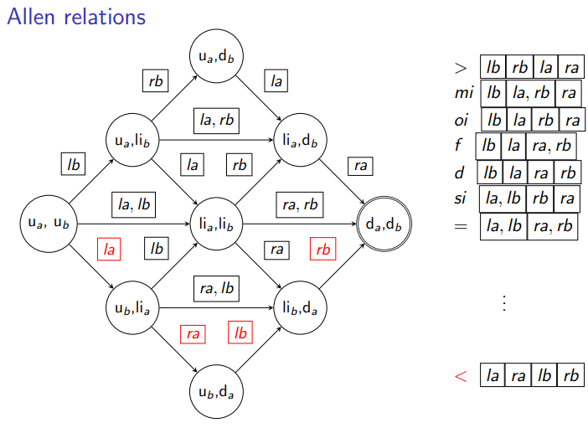
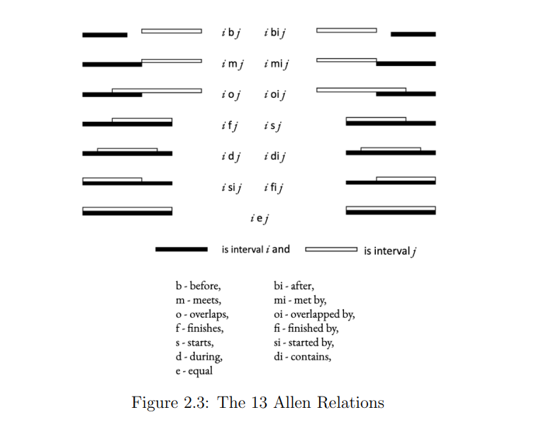
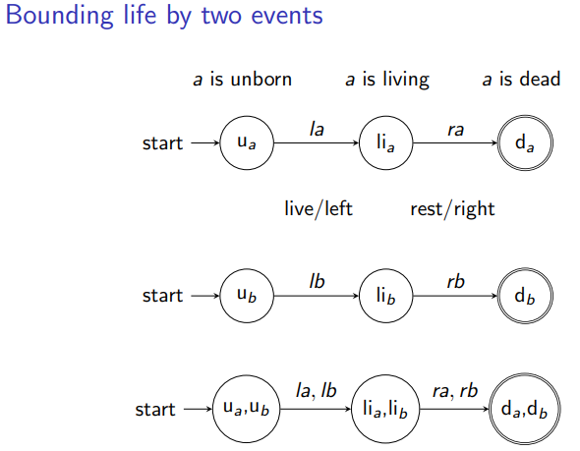
Allen interval relations
Allen's interval algebra is a calculus for temporal reasoning that was introduced by James F. Allen in 1983.

Slide 5
Action languages
Action languages are formal models of parts of the natural language that are used for talking about the effects of actions. Liclob 1998Linkoping University Electronic Press
Action Signatures
Transition System
Strips
Notes:
Explain fluent values, actions
An action signature consists of three nonempty sets a set V of value names a set F of uent names and a set A of action name

Slide 6
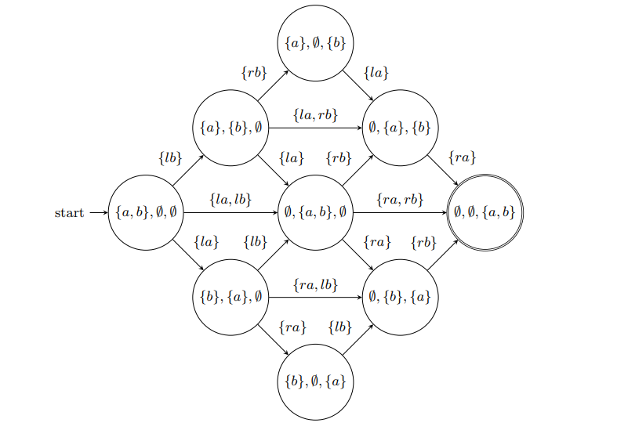
How these relate to frame problem
Combining action language to our case which we say in Allen relations
Notes:
Applying superposition to analyse action signatures to achieve this.
Fluent = person with values u, li, d (for unborn, living, dead). E.g. the U,L,D-state ({a}, {b}, ∅) assigns a the value u, and b the value li

Slide 7
Demo of artefacts

Slide 8
Implementation issues
The issues I faced were to understand the theory
Implementation of these into code was complex

Slide 9
Future work
Strips
Trying to analyze the problem

Slide 10
Questions ?

Slide 11
Thank You

